Slide 1
Elderly Mobile Life Assistant for Family Members with Extra Peace of Mind
Final Year Project
Group Name : Whale Did You Go?
Supervisor : Kelvin Lee
Team Member :
Leung Kwan Ho 12123629
Au Chi Chung 12017765
Lie Tze Wah 12123709

Slide 2
Project Outline
“
1
— Existing Problems

Slide 3
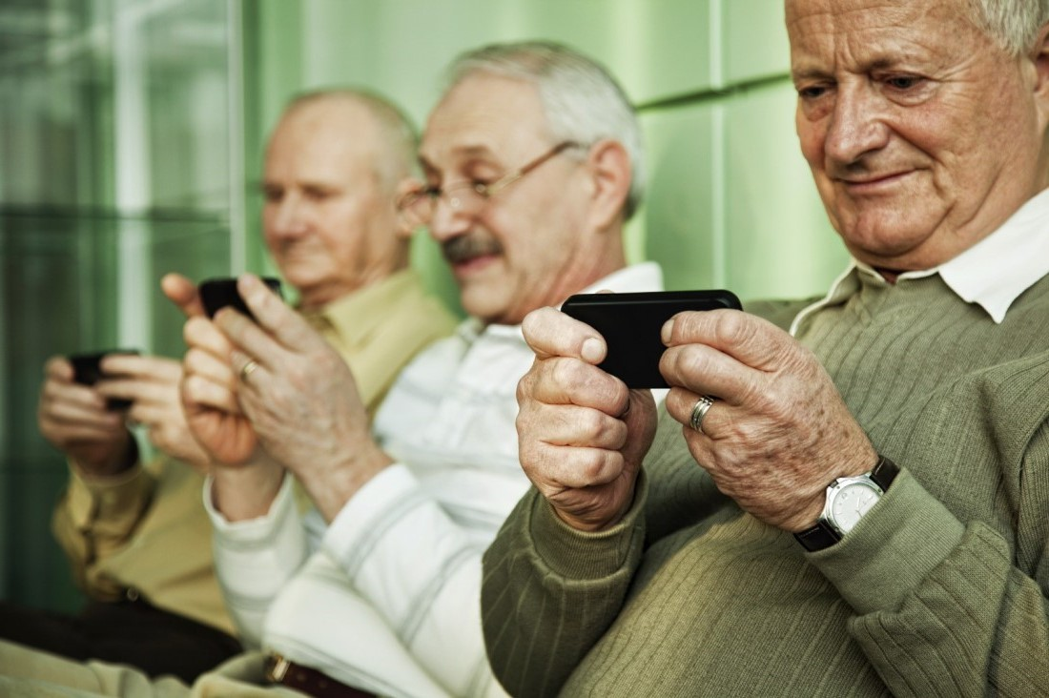
Complicated features in Smartphones
Project Outline : Problem 1

Slide 4

Features of Smart Phone
Project Outline
Do you know why elderly think smartphones are difficult to use?
Lots of features ➔ Useless for elderly
User interface ➔ Small buttons and icons
Not user-friendly

Slide 5
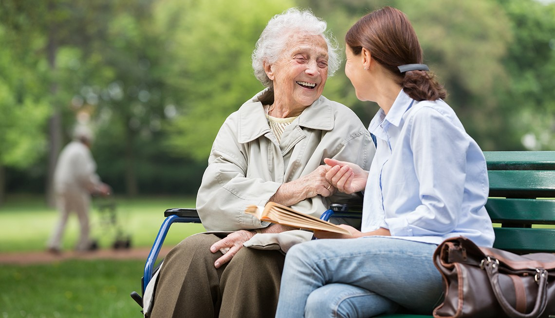
Accidents of Elderly
Project Outline : Problem 2

Slide 6
Project Outline
References :
Centre for Health Protection (September 2010). Unintentional Injury Survey - “Accidental Injury Survey 2008”
Department of Health Retrieved from
https://www.chp.gov.hk/files/pdf/injury_survey_eng.pdf

Slide 7
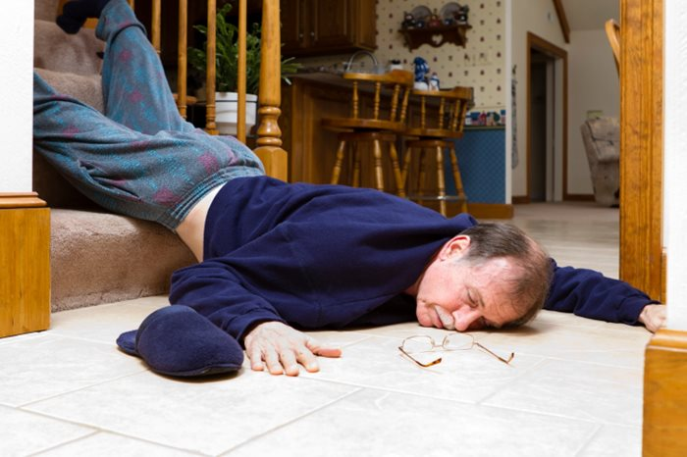
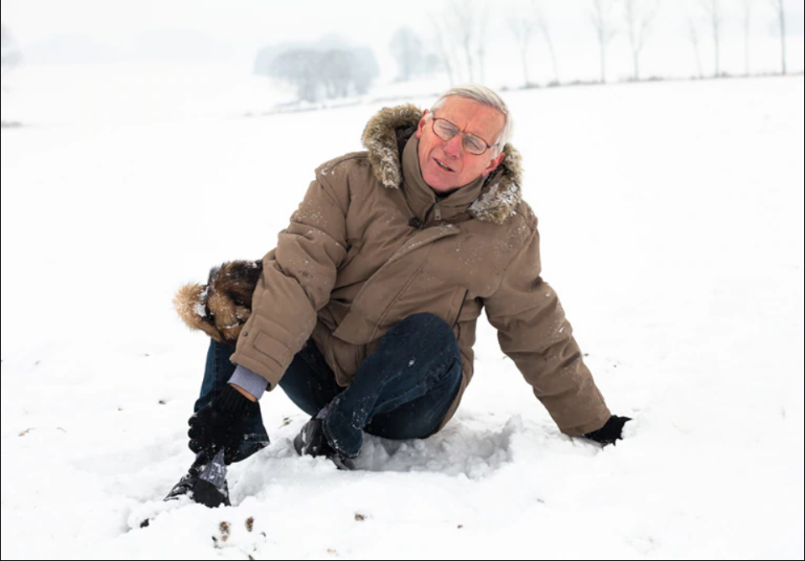
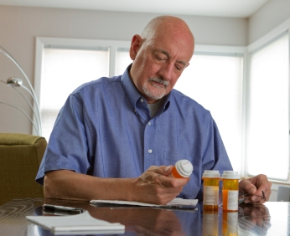
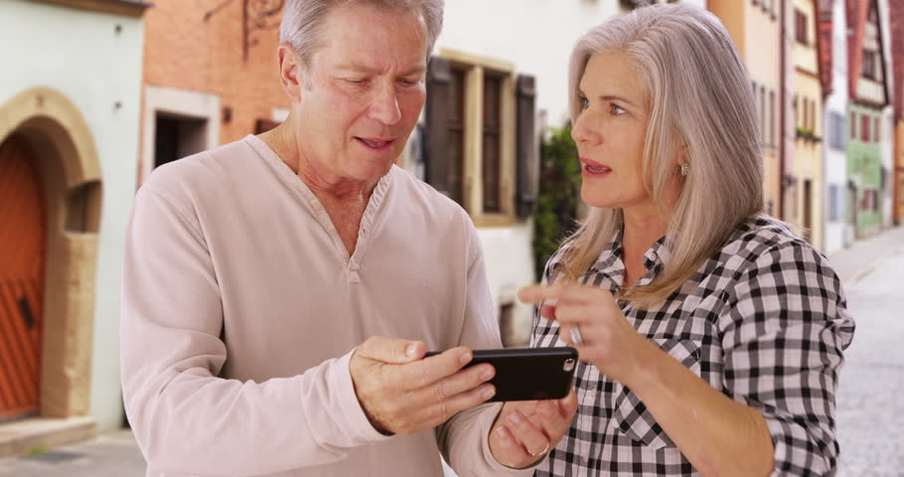
The most common accidents encountered by the elderly
Project Outline
Falls / Slip ( 32.2% )
Sprain ( 25.8% )
Forget to take medicine ( 14.1% )
Get lost ( 13.7% )
References :
Centre for Health Protection (September 2010). Unintentional Injury Survey - “Accidental Injury Survey 2008”
Department of Health Retrieved from
https://www.chp.gov.hk/files/pdf/injury_survey_eng.pdf

Slide 8
Project Objectives
“
2
— Main Functions of the Mobile Application

Slide 9
The application aims for ...
Project Objectives
Add-on functions
Low Priority
Elderly daily life management
Safety of elderly
Focus on families with elderly
Simple interface
High Priority

Slide 10
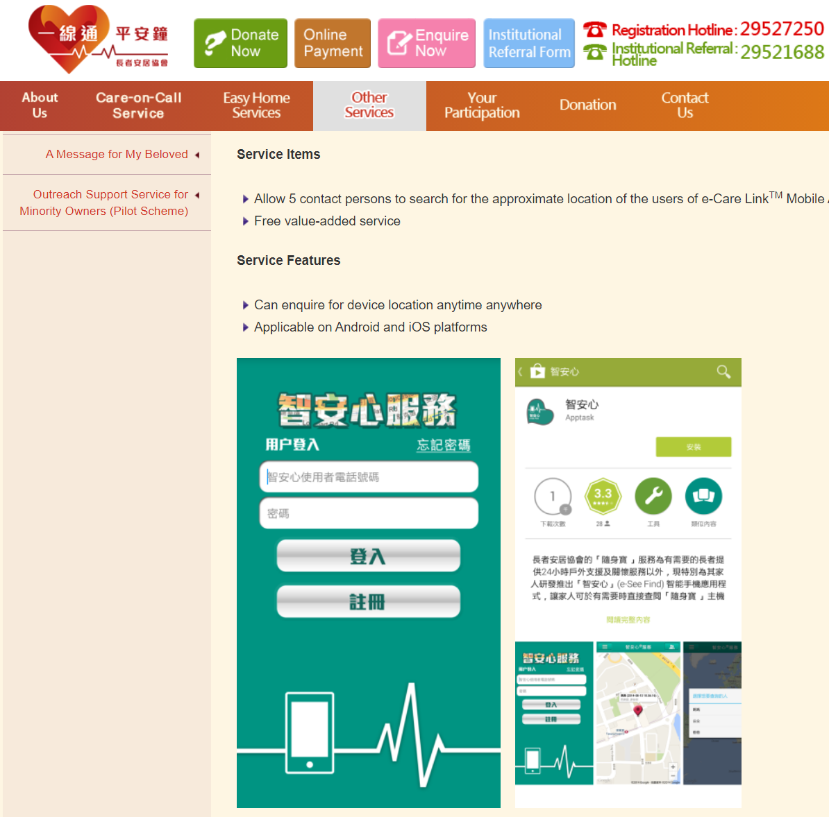
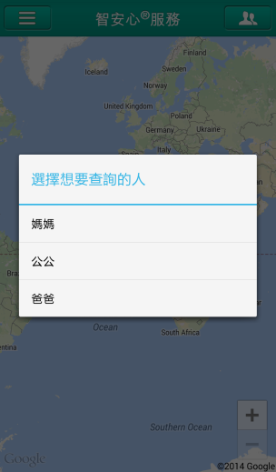
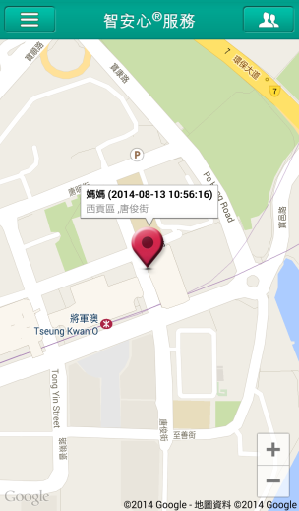
Existing Solution
References :
Senior Citizen Home Safety Association. e-See Find Service
Senior Citizen Home Safety Association Retrieved from
https://www.schsa.org.hk/en/services/safe_services/addvalue/eseefind/index.html

Slide 11
Methodology
“
3
— Current System Design

Slide 12
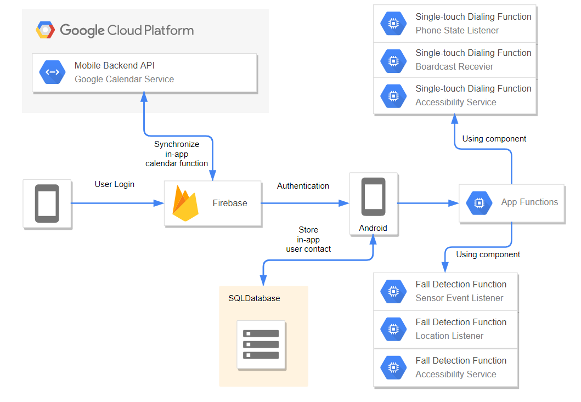
Base Technologies

Slide 13
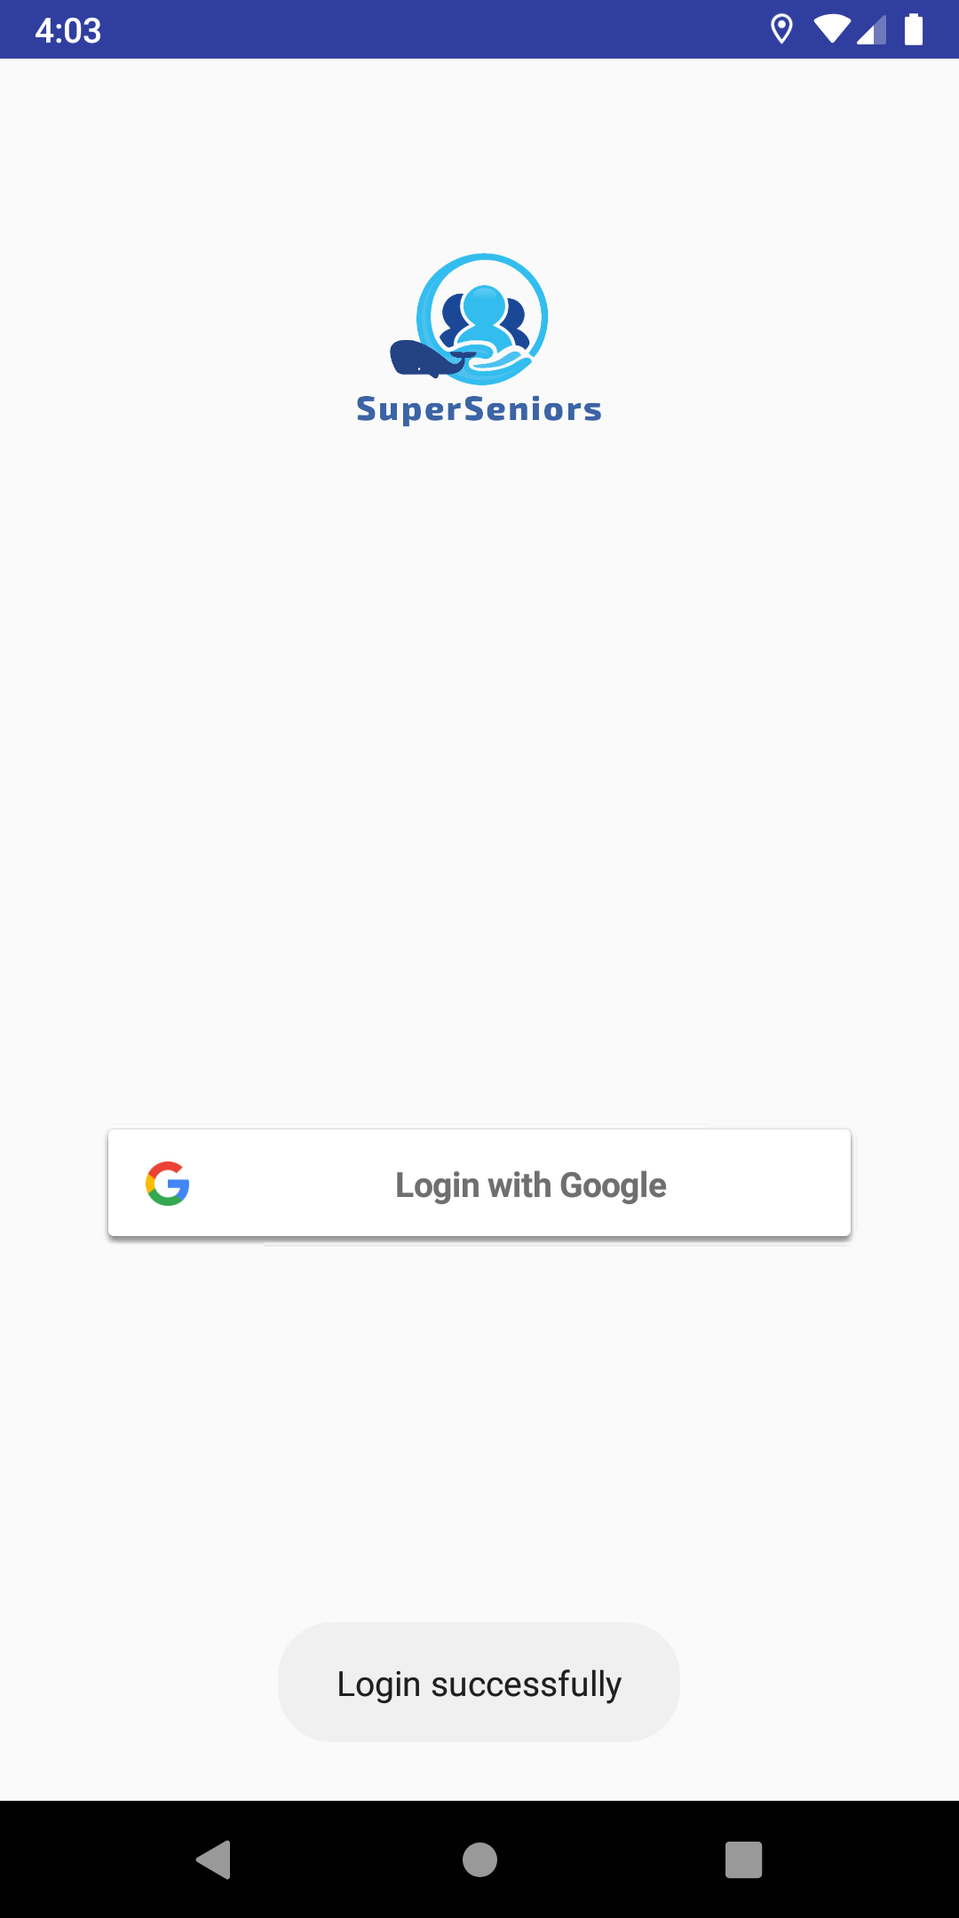
Login
Major Functions
Using Firebase with Google API service for getting user information in Google calendar and fall-detection message

Slide 14
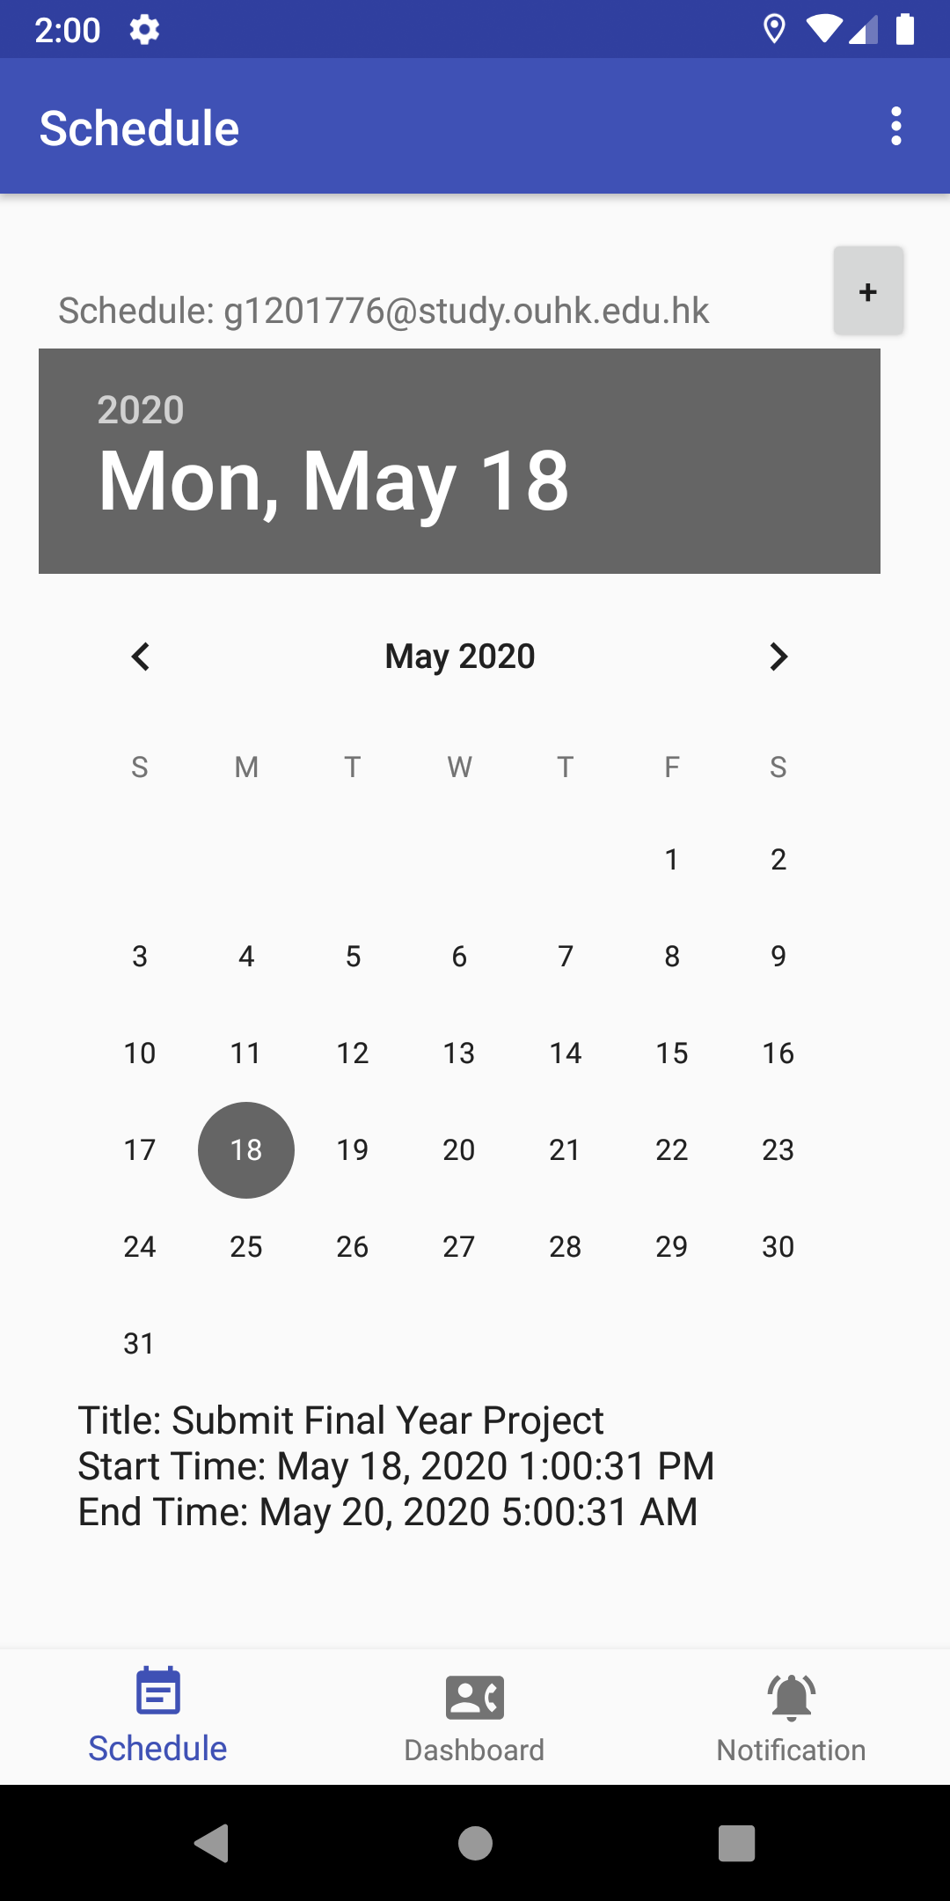
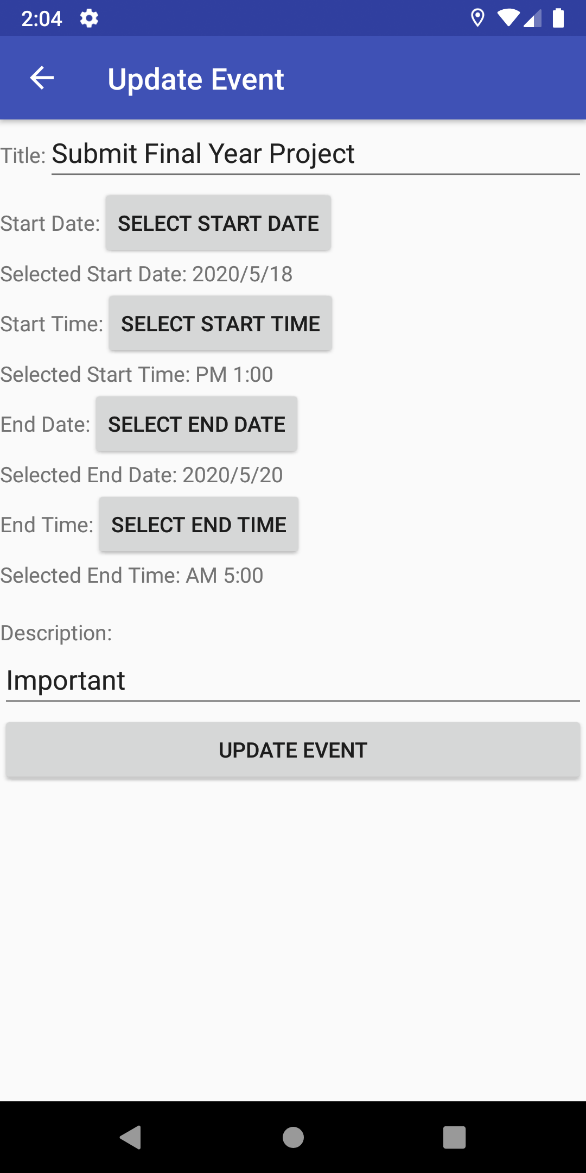
Calendar
Major Functions
Daily remainder connecting with Google Calendar
Notification for each tasks
Solved the project objective of “Elderly daily life management”

Slide 15
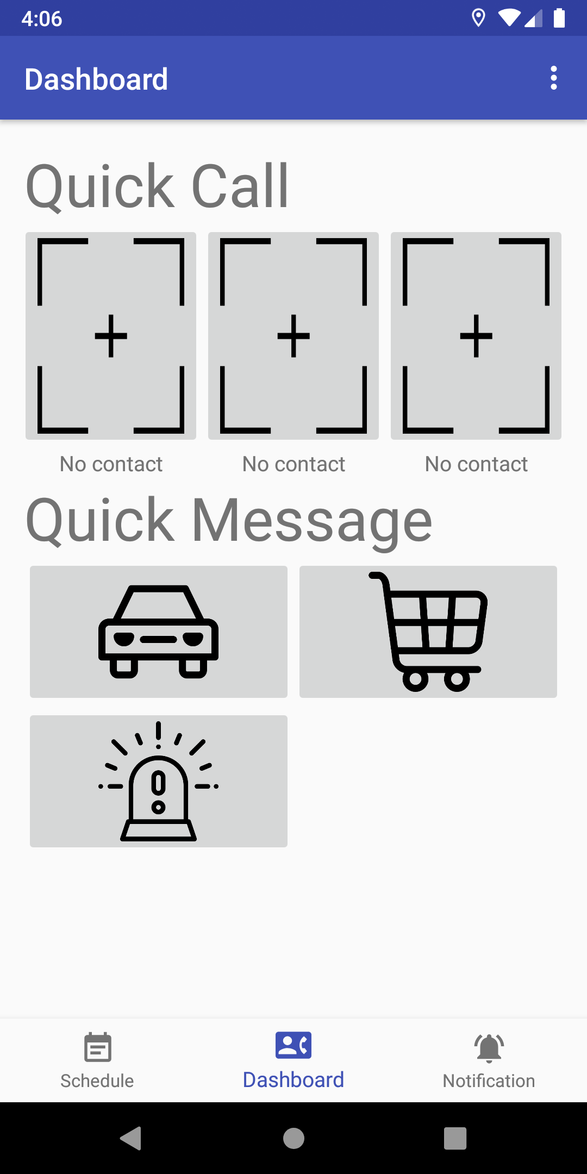
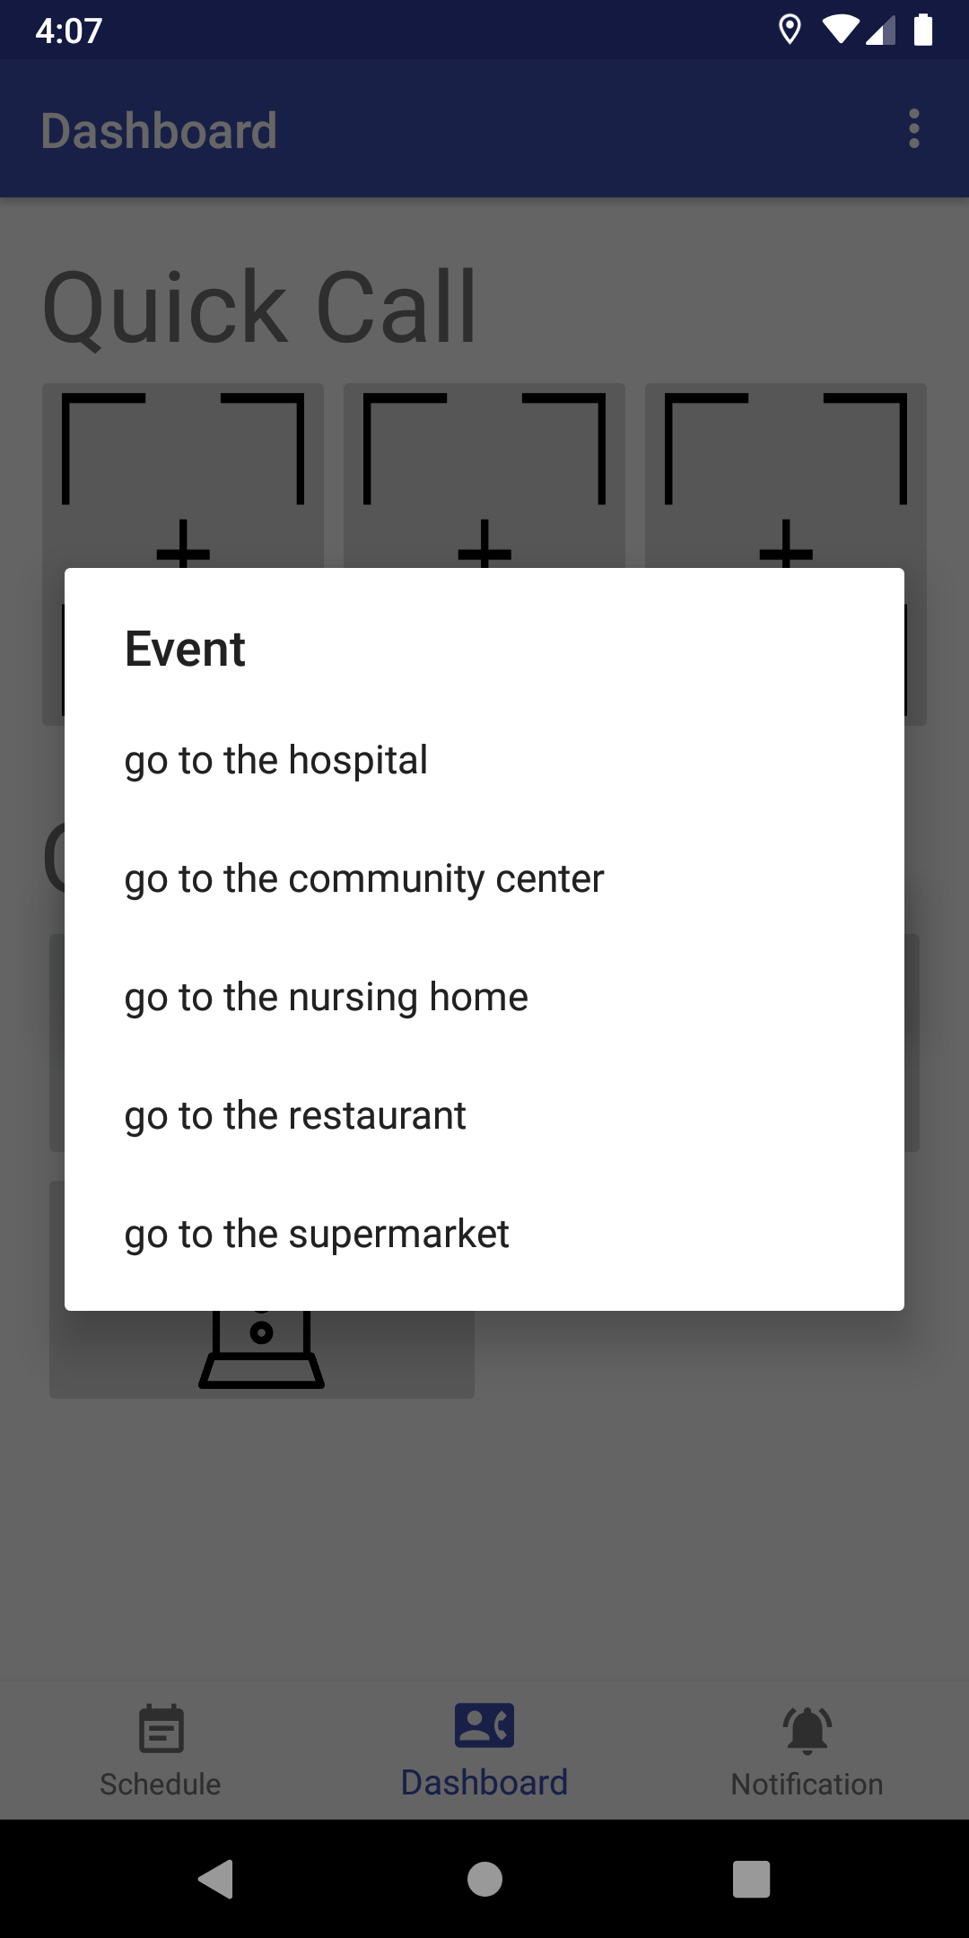
Quick SMS Message
Major Functions
Single Touch Dialing
Dialing cycle until successful connection
Send SMS by selecting simple options button
Solved the project objective of “Elderly daily life management”

Slide 16
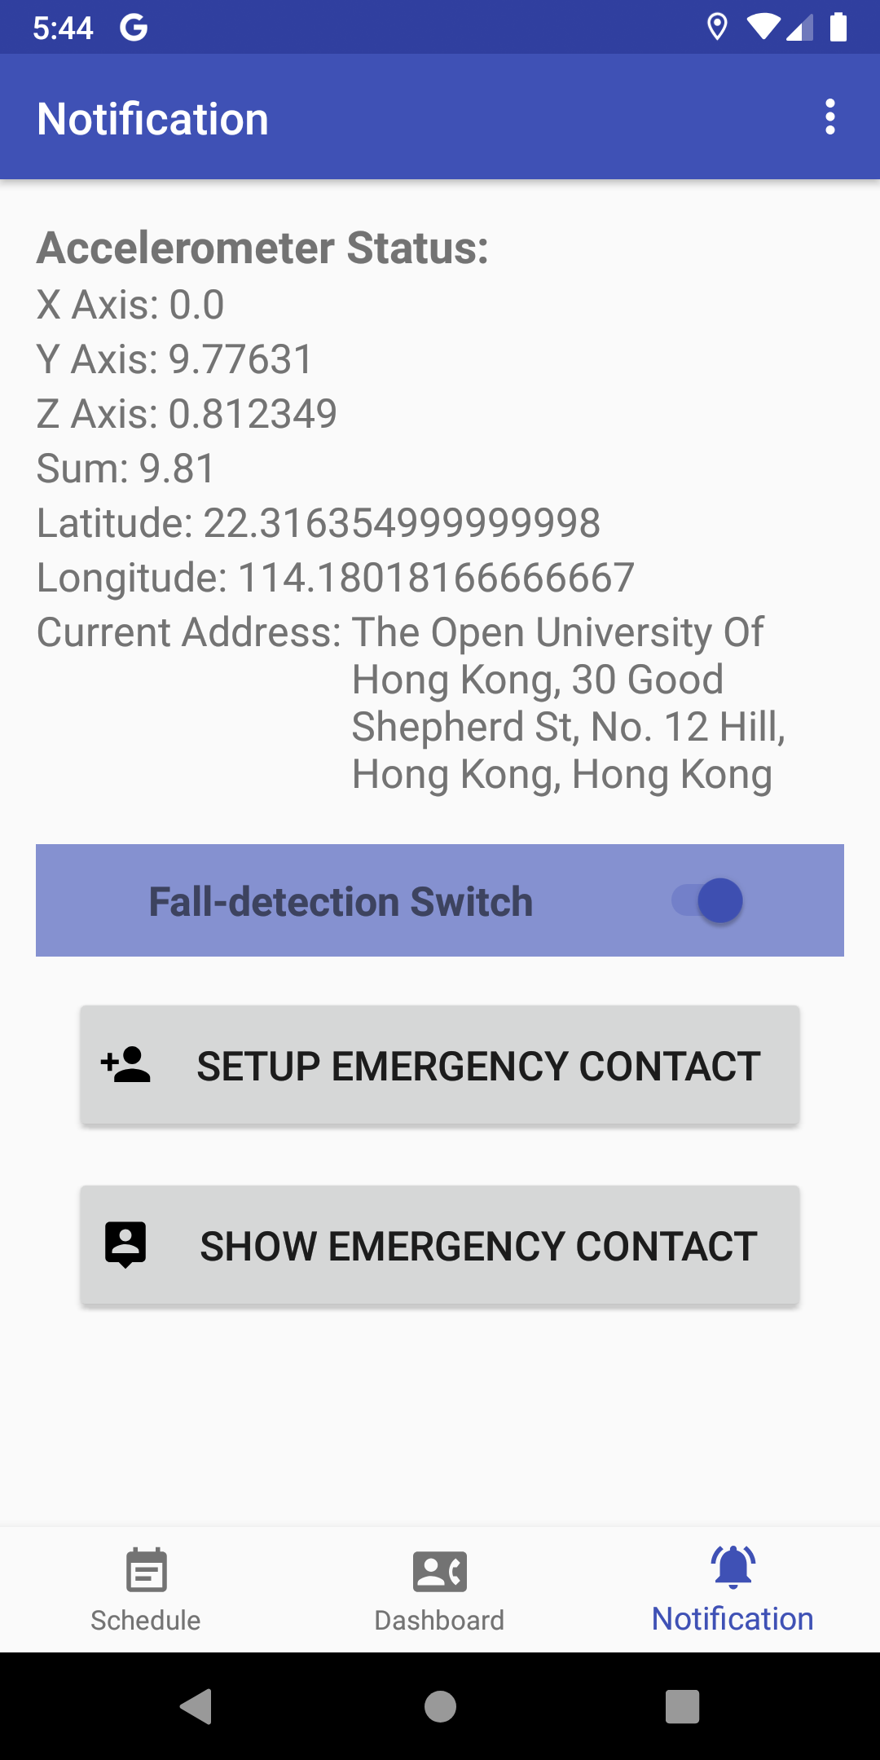
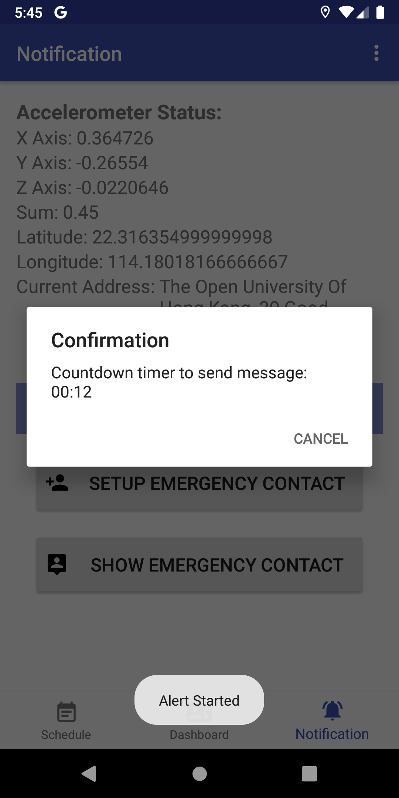
Fall-detection
Major Functions
Alert ringtone and send SMS to the emergency contact
Solved the project objective of “Elderly Safety”

Slide 17
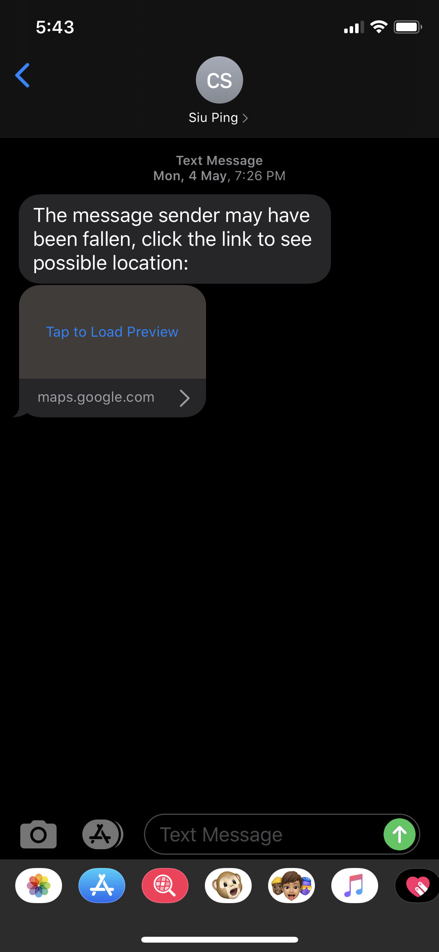
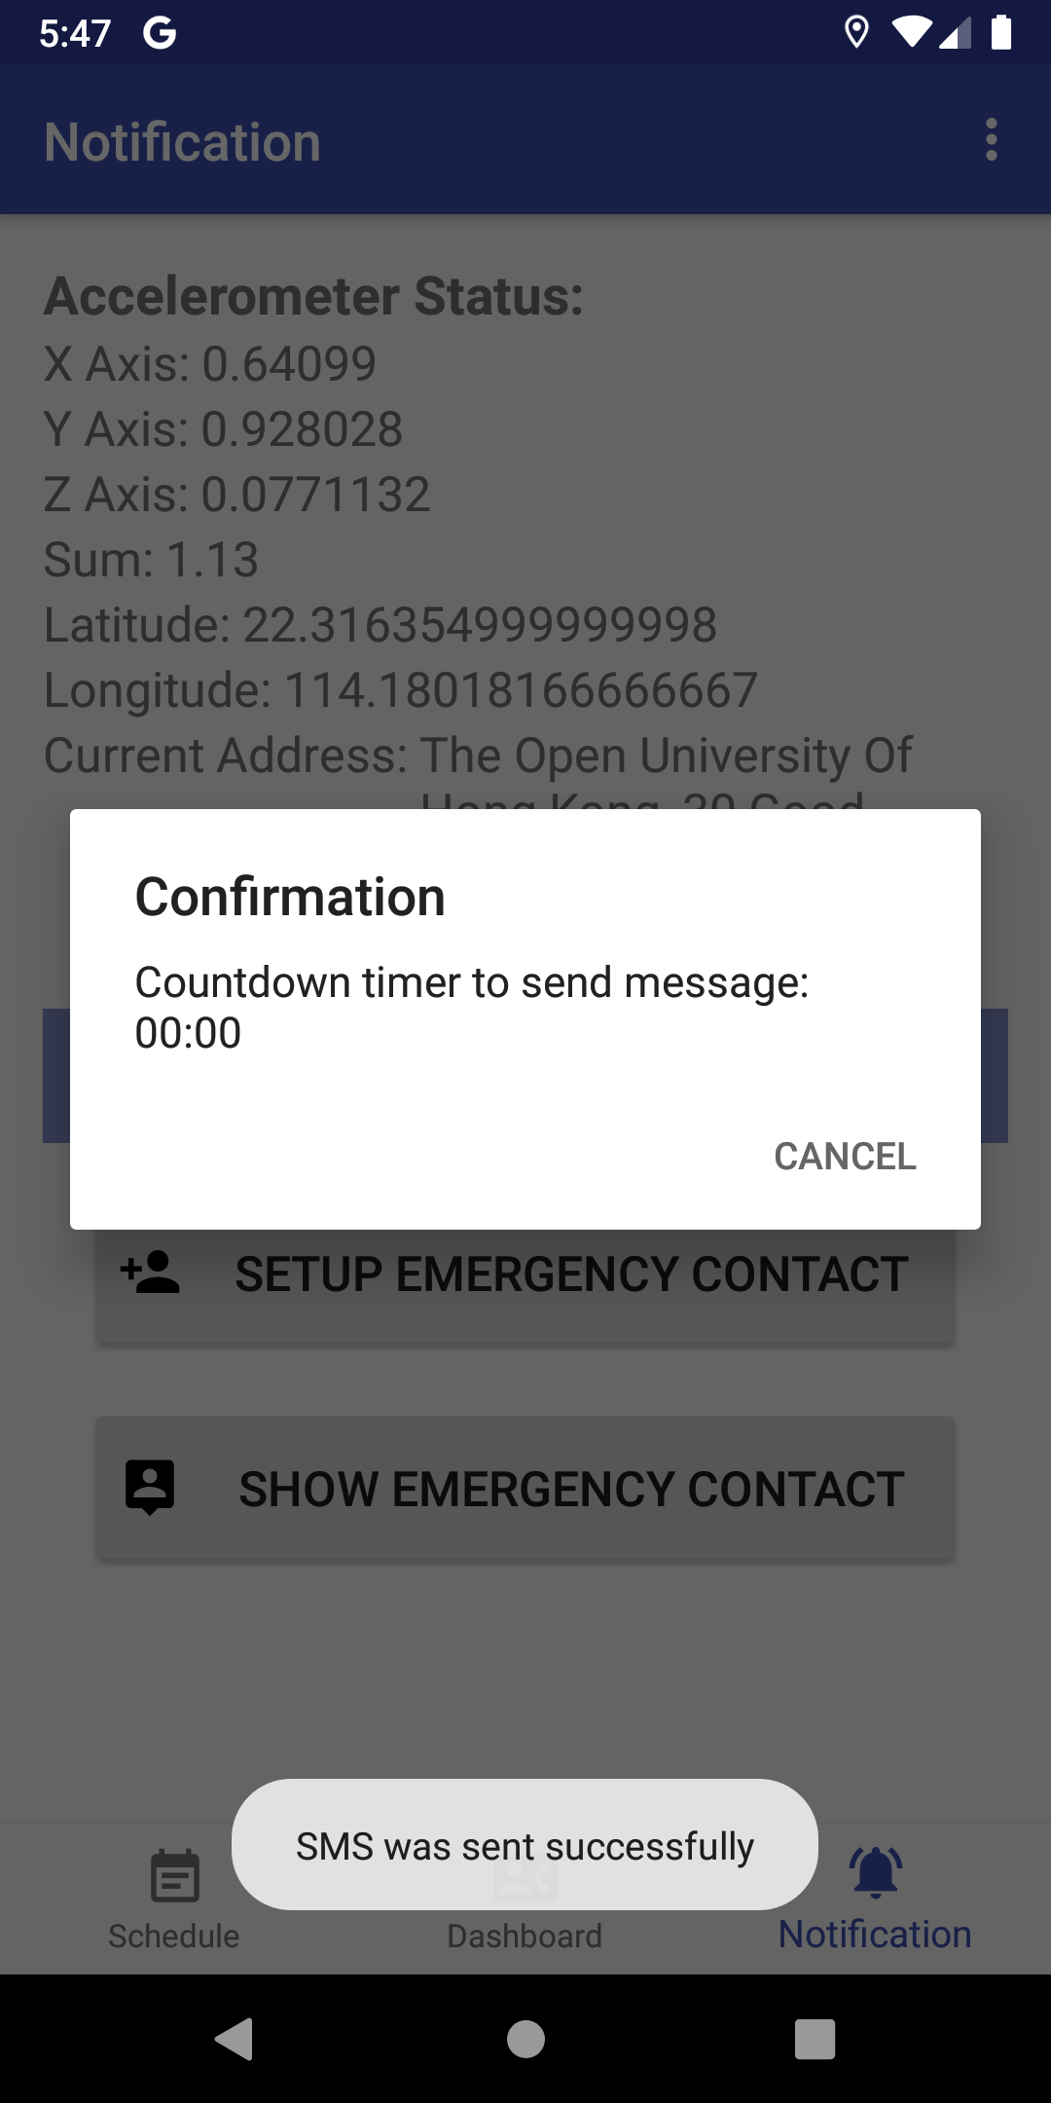
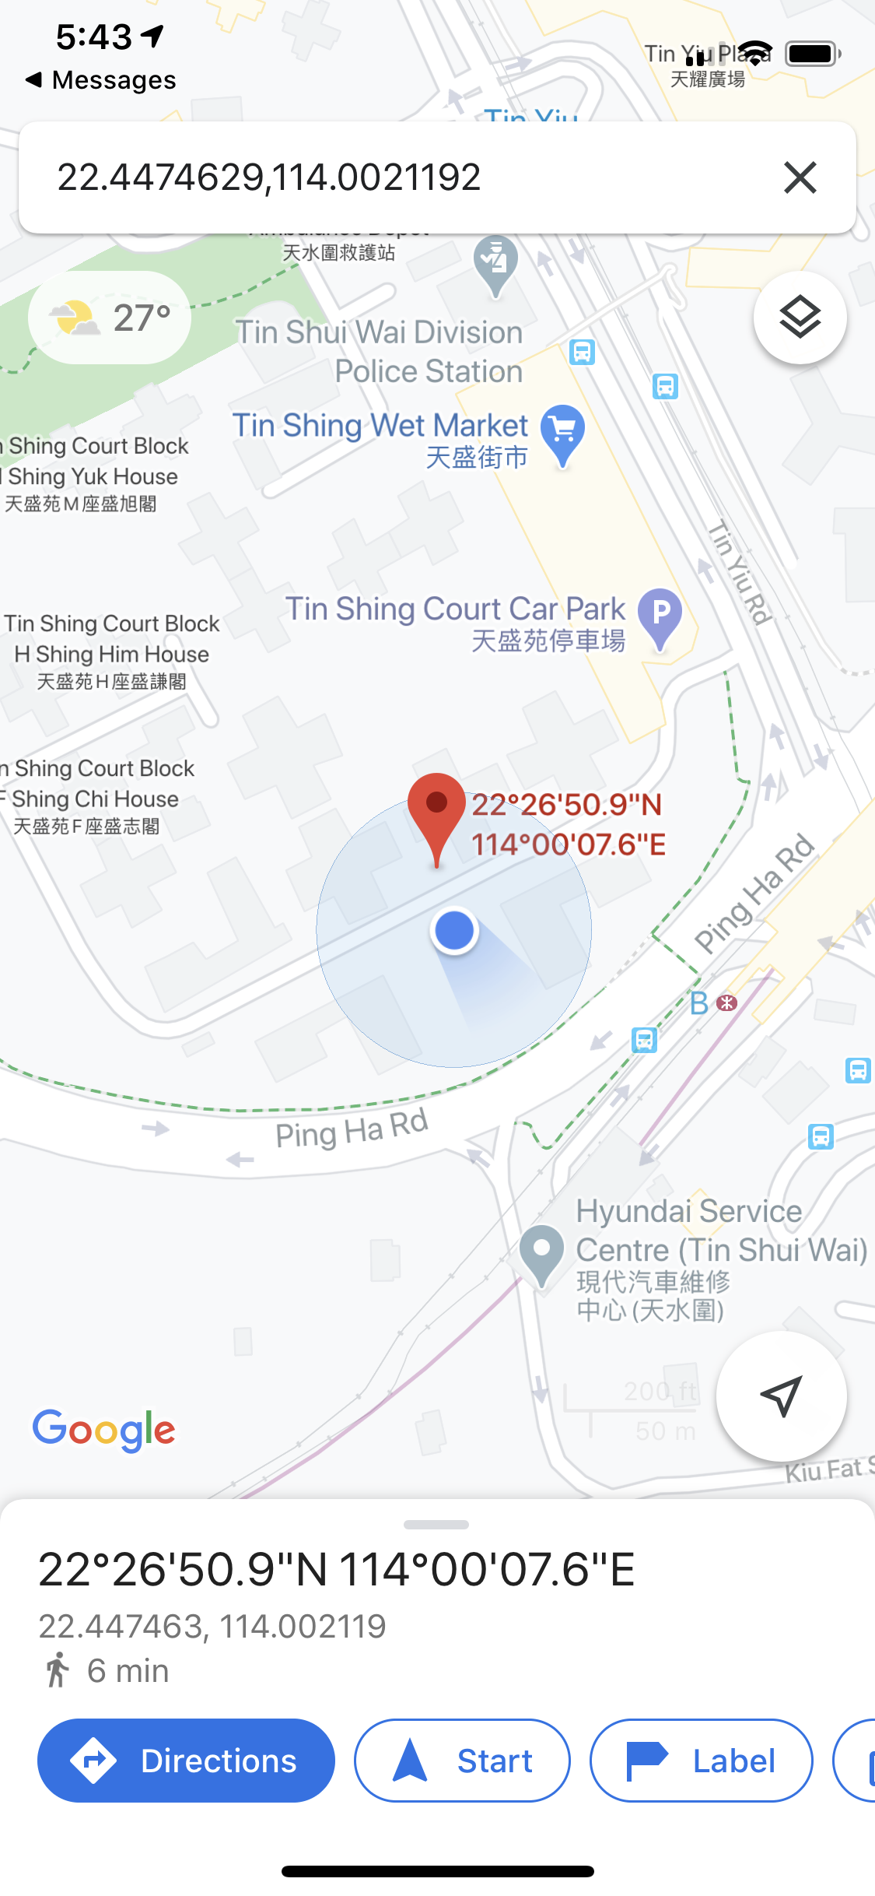
Fall-detection
Major Functions
After the SMS message send to the emergency contact, he can get the current location from sender

Slide 18
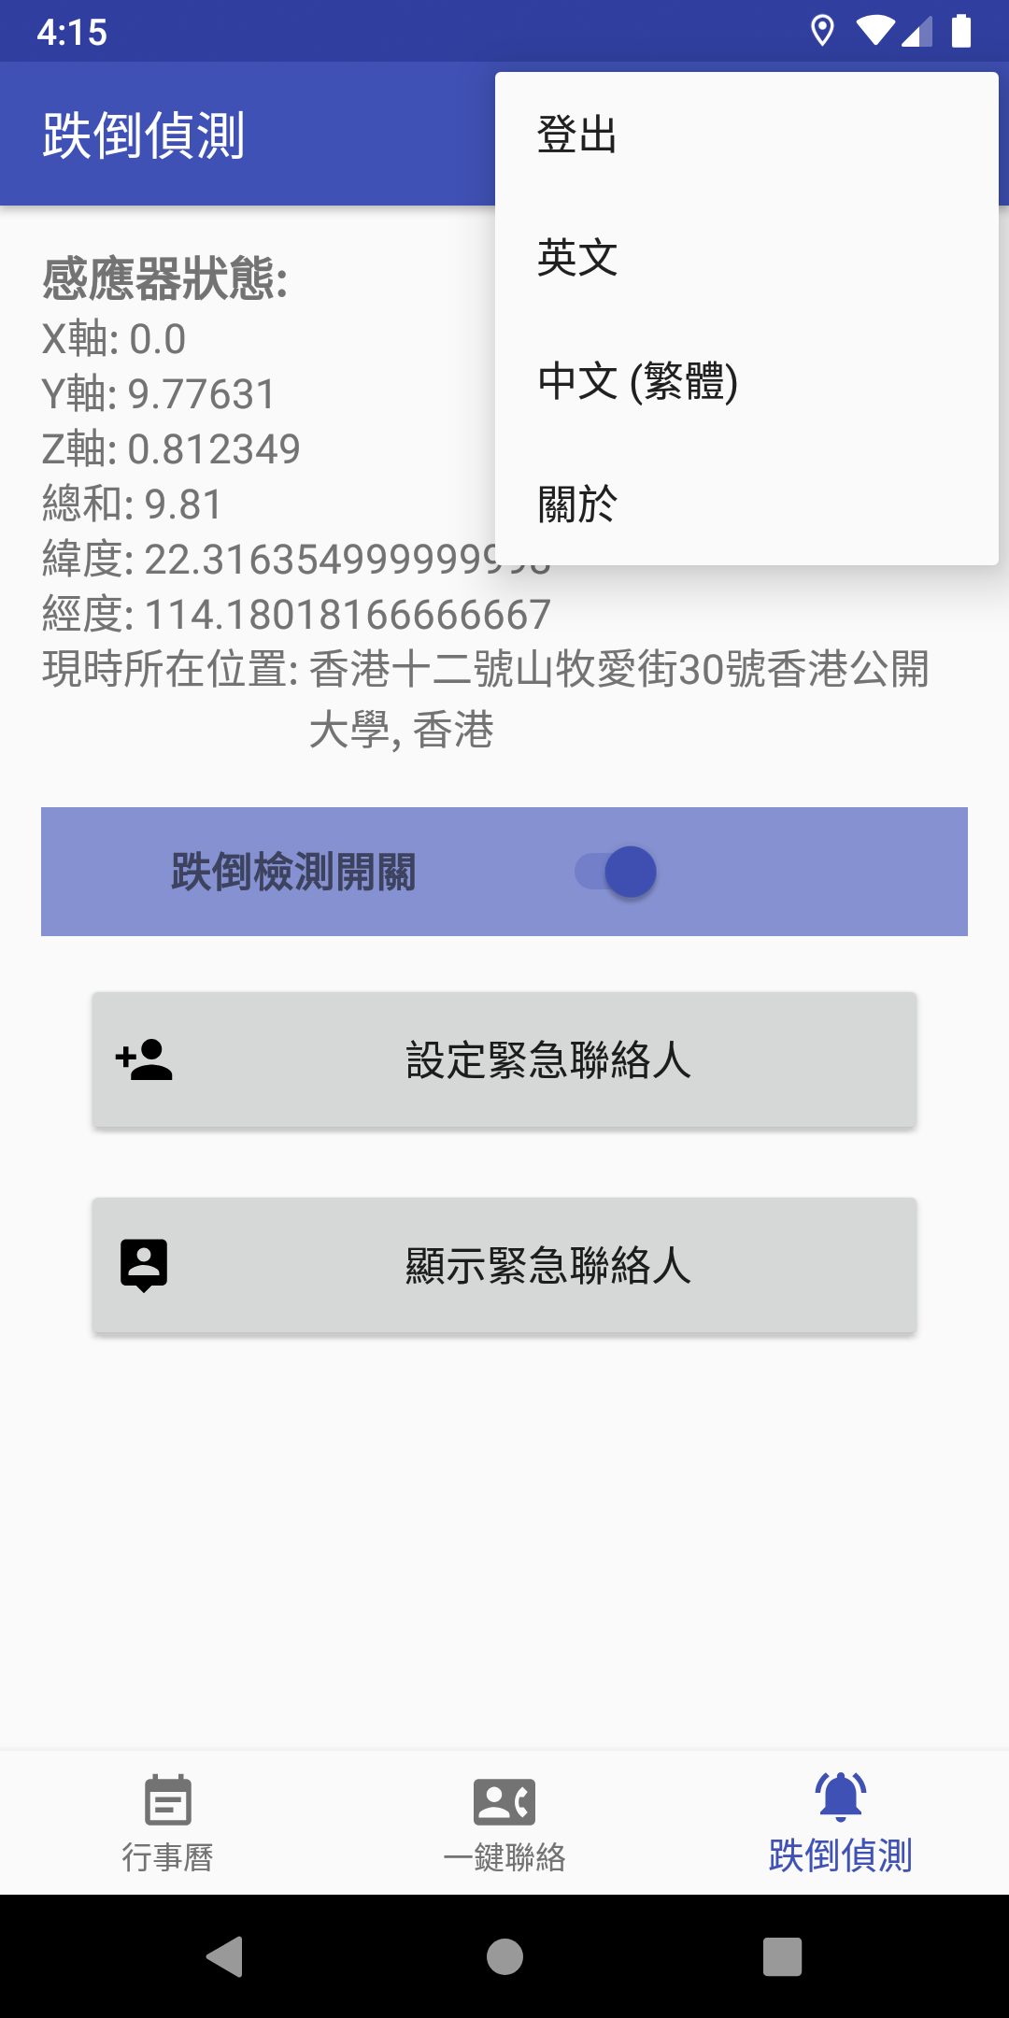
Multi-Language
Major Functions
Provide English and Traditional Chinese for different type of users

Slide 19
Evaluation Plan
“
4
— Objectives Achievement of Development

Slide 20
Evaluation Method : Pre-Post Study
Evaluation Plan
Step 1
Step 2
Step 3
Step 4
Select 8 users for a trial of the prototype
Take survey before using the prototype
Download the application from the link and test
Take survey after used the prototype

Slide 21
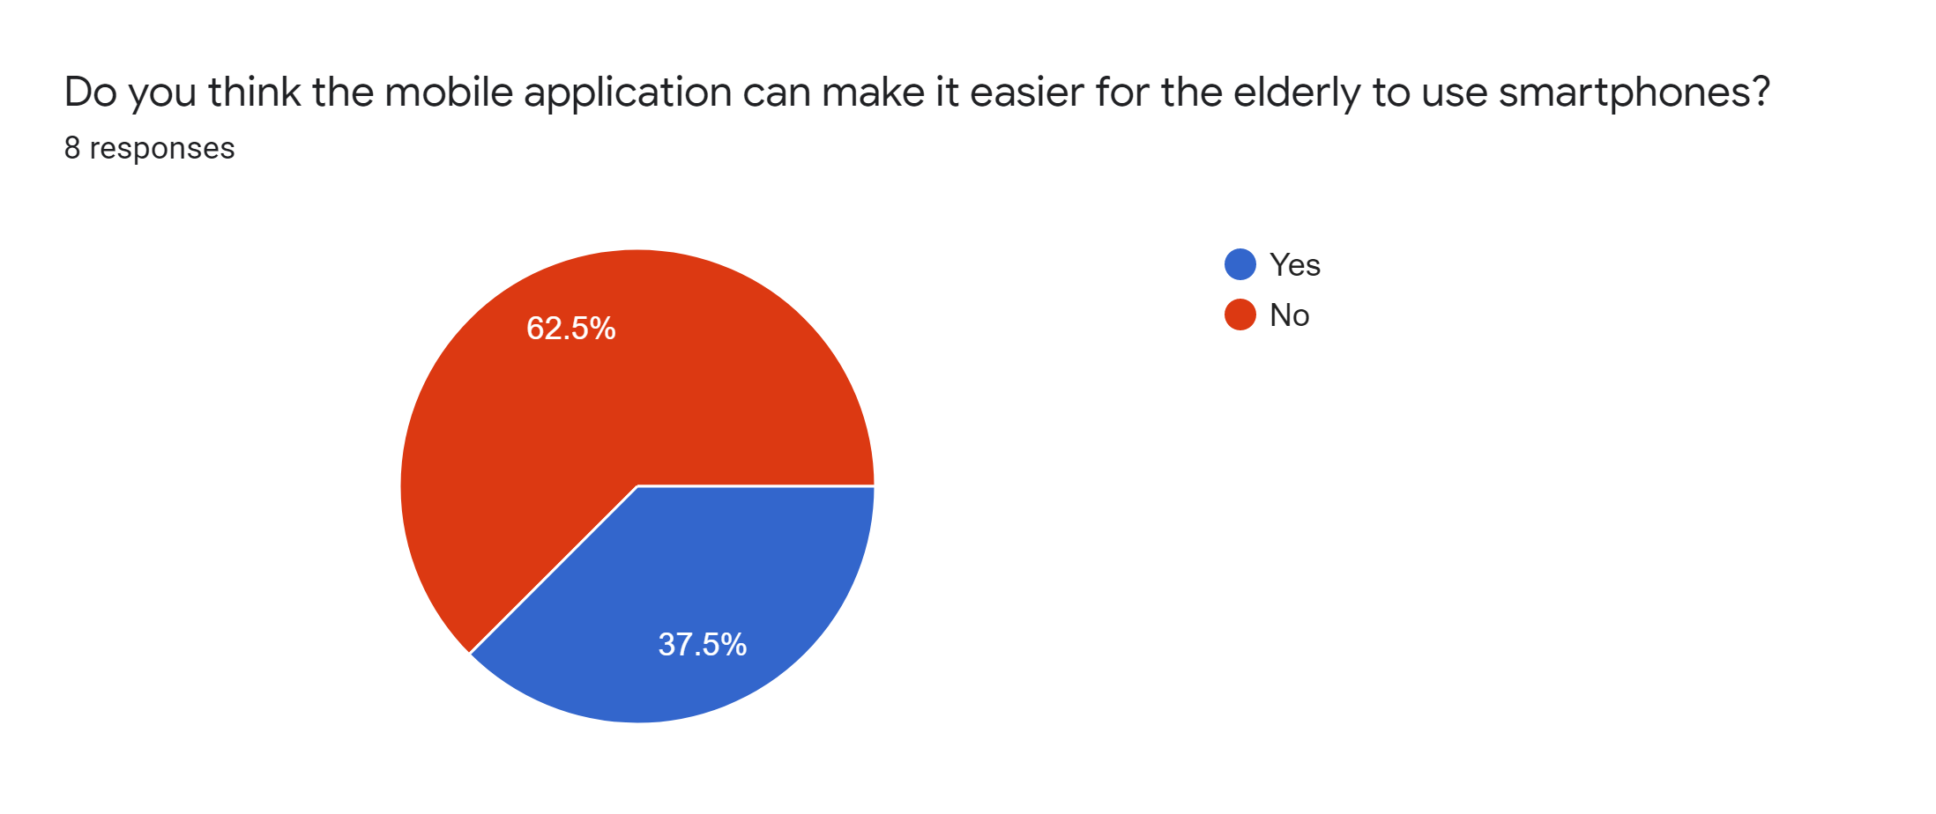
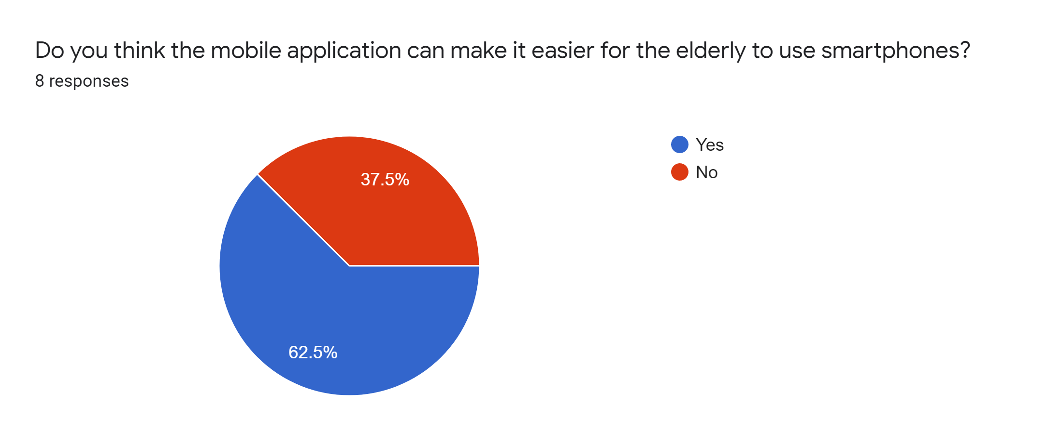
Evaluation Study #1
Before test of the application
2 users change his / her mind after used the application
After test of the application

Slide 22
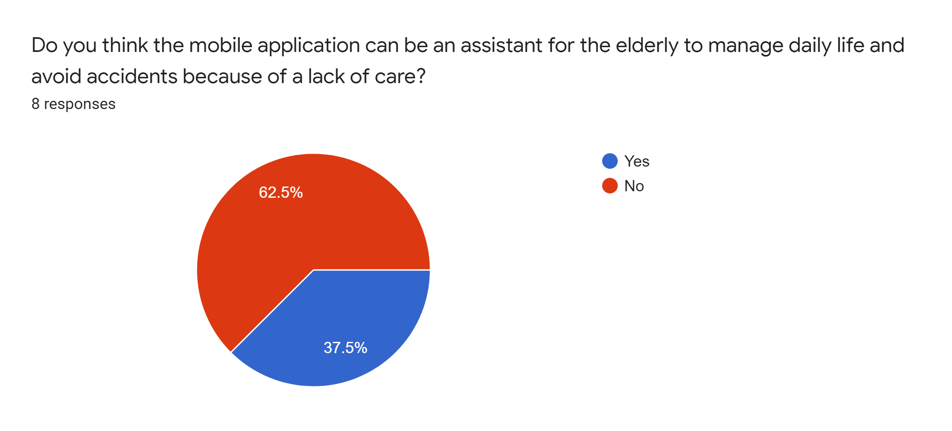
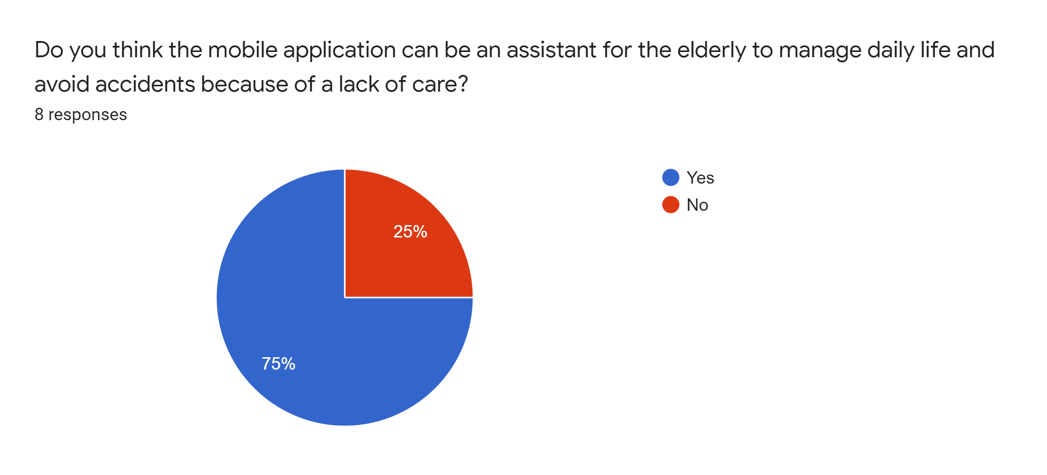
Evaluation Study #2
Before test of the application
3 users change his / her mind after used the application
After test of the application

Slide 23
Conclusion
“
5
— Conclusion and Future Work

Slide 24
Conclusion
Summary of achievements
Most of the aim given in the project background have been satisfied
Implemented and tested on real devices
Improvement
User interface can more simply
Functions is not rich enough

Slide 25

Google Map
Future Work
Provide the map for tracking the current location to users
In-app Notification
Some message can display via
in-app notification
Voice Control
Single touch dialing, and short message operate via voice control
Better UI Design
User interface can design simpler to help elderly for use

Slide 26
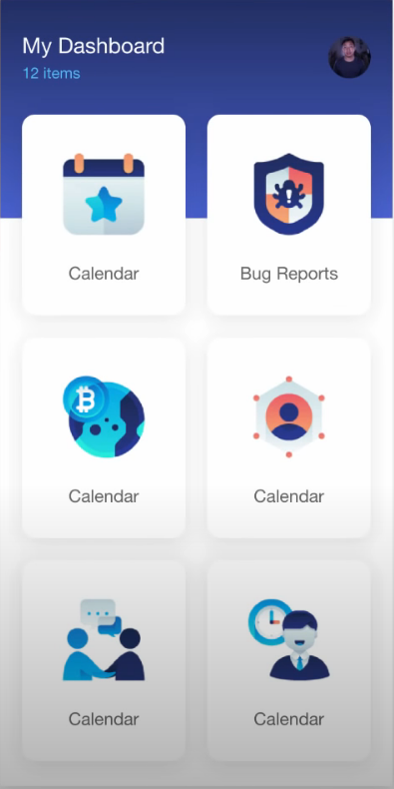
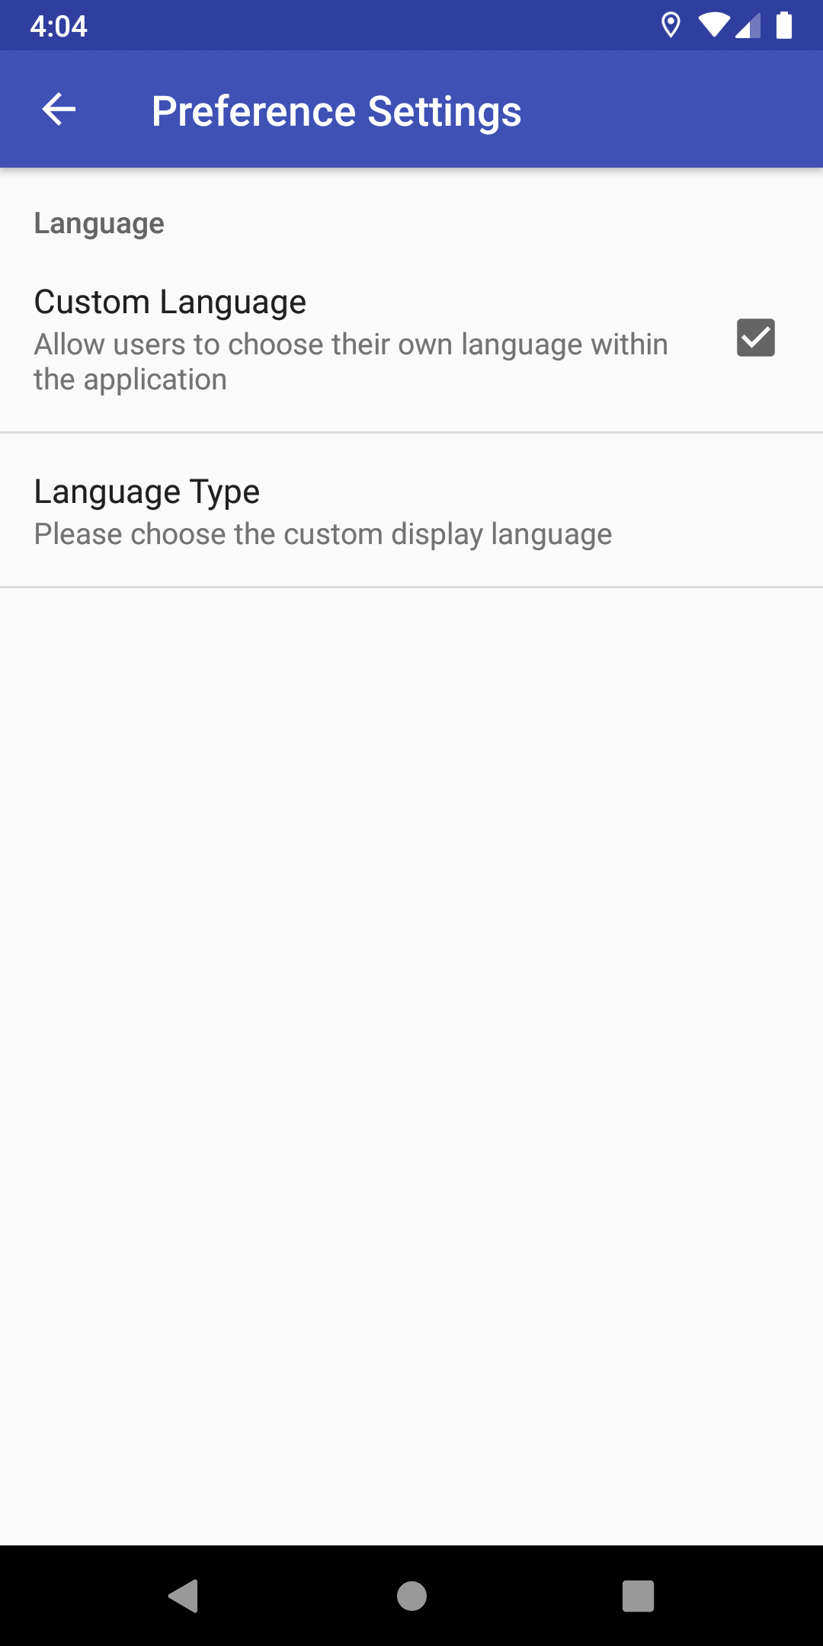
Future Work : Better UI Design
Dashboard Control Page
Preference Settings Page

Slide 27
Thanks!
This is the end of the presentation

